Slide 1
Chapter 7: Relational Database Design
Notes:
‹#›

Slide 2
Chapter 7: Relational Database Design
Features of Good Relational Design
Atomic Domains and First Normal Form
Decomposition Using Functional Dependencies
Functional Dependency Theory
Algorithms for Functional Dependencies
Decomposition Using Multivalued Dependencies
More Normal Form
Database-Design Process
Modeling Temporal Data

Slide 3
The Banking Schema
branch = (branch_name, branch_city, assets)
customer = (customer_id, customer_name, customer_street, customer_city)
loan = (loan_number, amount)
account = (account_number, balance)
employee = (employee_id. employee_name, telephone_number, start_date)
dependent_name = (employee_id, dname)
account_branch = (account_number, branch_name)
loan_branch = (loan_number, branch_name)
borrower = (customer_id, loan_number)
depositor = (customer_id, account_number)
cust_banker = (customer_id, employee_id, type)
works_for = (worker_employee_id, manager_employee_id)
payment = (loan_number, payment_number, payment_date, payment_amount)
savings_account = (account_number, interest_rate)
checking_account = (account_number, overdraft_amount)

Slide 4
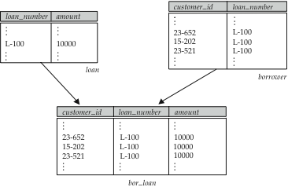
Combine Schemas?
Suppose we combine borrower and loan to get
bor_loan = (customer_id, loan_number, amount )
Result is possible repetition of information (L-100 in example below)

Slide 5
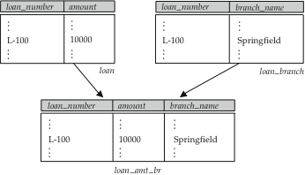
A Combined Schema Without Repetition
Consider combining loan_branch and loan
loan_amt_br = (loan_number, amount, branch_name)
No repetition (as suggested by example below)

Slide 6
What About Smaller Schemas?
Suppose we had started with bor_loan. How would we know to split up (decompose) it into borrower and loan?
Write a rule “if there were a schema (loan_number, amount), then loan_number would be a candidate key”
Denote as a functional dependency:
loan_number → amount
In bor_loan, because loan_number is not a candidate key, the amount of a loan may have to be repeated. This indicates the need to decompose bor_loan.
Not all decompositions are good. Suppose we decompose employee into
employee1 = (employee_id, employee_name)
employee2 = (employee_name, telephone_number, start_date)
The next slide shows how we lose information -- we cannot reconstruct the original employee relation -- and so, this is a lossy decomposition.

Slide 7
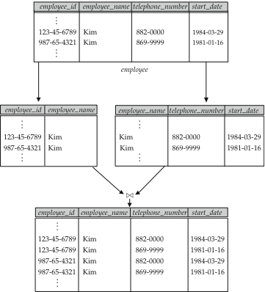
A Lossy Decomposition

Slide 8
First Normal Form
Domain is atomic if its elements are considered to be indivisible units
Examples of non-atomic domains:
Set of names, composite attributes
Identification numbers like CS101 that can be broken up into parts
A relational schema R is in first normal form if the domains of all attributes of R are atomic
Non-atomic values complicate storage and encourage redundant (repeated) storage of data
Example: Set of accounts stored with each customer, and set of owners stored with each account
We assume all relations are in first normal form (and revisit this in Chapter 9)

Slide 9
First Normal Form (Cont’d)
Atomicity is actually a property of how the elements of the domain are used.
Example: Strings would normally be considered indivisible
Suppose that students are given roll numbers which are strings of the form CS0012 or EE1127
If the first two characters are extracted to find the department, the domain of roll numbers is not atomic.
Doing so is a bad idea: leads to encoding of information in application program rather than in the database.

Slide 10
Goal — Devise a Theory for the Following
Decide whether a particular relation R is in “good” form.
In the case that a relation R is not in “good” form, decompose it into a set of relations {R₁, R₂, ..., R_{n}} such that
each relation is in good form
the decomposition is a lossless-join decomposition
Our theory is based on:
functional dependencies
multivalued dependencies

Slide 11
Functional Dependencies
Constraints on the set of legal relations.
Require that the value for a certain set of attributes determines uniquely the value for another set of attributes.
A functional dependency is a generalization of the notion of a key.

Slide 12
Functional Dependencies (Cont.)
Let R be a relation schema
α ⊆ R and β ⊆ R
The functional dependency
α → β holds on R if and only if for any legal relations r(R), whenever any two tuples t₁ and t₂ of r agree on the attributes α, they also agree on the attributes β. That is,
t₁[α] = t₂ [α] ⇒ t₁[β ] = t₂ [β ]
Example: Consider r(A,B ) with the following instance of r.
On this instance, A → B does NOT hold, but B → A does hold.
4
1 5
3 7

Slide 13
Functional Dependencies (Cont.)
K is a superkey for relation schema R if and only if K → R
K is a candidate key for R if and only if
K → R, and
for no α ⊂ K, α → R
Functional dependencies allow us to express constraints that cannot be expressed using superkeys. Consider the schema:
bor_loan = (customer_id, loan_number, amount ).
We expect this functional dependency to hold:
loan_number → amount
but would not expect the following to hold:
amount → customer_name

Slide 14
Use of Functional Dependencies
We use functional dependencies to:
test relations to see if they are legal under a given set of functional dependencies.
If a relation r is legal under a set F of functional dependencies, we say that r satisfies F.
specify constraints on the set of legal relations
We say that F holds on R if all legal relations on R satisfy the set of functional dependencies F.
Note: A specific instance of a relation schema may satisfy a functional dependency even if the functional dependency does not hold on all legal instances.
For example, a specific instance of loan may, by chance, satisfy amount → customer_name.

Slide 15
Functional Dependencies (Cont.)
A functional dependency is trivial if it is satisfied by all instances of a relation
Example:
customer_name, loan_number → customer_name
customer_name → customer_name
In general, α → β is trivial if β ⊆ α
R(A,B,C,D,E)
F(A—B, D—E)
R(A,B,C,D)
F(A—B, B—C, C—A)
F(AB—CD, D—B, C—A)

Slide 16
Closure of a Set of Functional Dependencies
Given a set F of functional dependencies, there are certain other functional dependencies that are logically implied by F.
For example: If A → B and B → C, then we can infer that A → C
The set of all functional dependencies logically implied by F is the closure of F.
We denote the closure of F by F⁺.
F⁺ is a superset of F.

Slide 17
Boyce-Codd Normal Form
A relation schema R is in BCNF with respect to a set F of functional dependencies if for all functional dependencies in F⁺ of the form
α → β
where α ⊆ R and β ⊆ R, at least one of the following holds:
α  → β is trivial (i.e., β ⊆ α)
α is a superkey for R
Example schema not in BCNF:
bor_loan = ( customer_id, loan_number, amount )
because loan_number → amount holds on bor_loan but loan_number is not a superkey

Slide 18
Decomposing a Schema into BCNF
Suppose we have a schema R and a non-trivial dependency α →β causes a violation of BCNF.
We decompose R into:
(α U β )
( R - ( β - α ) )
In our example,
α = loan_number
β = amount
and bor_loan is replaced by
(α U β ) = ( loan_number, amount )
( R - ( β - α ) ) = ( customer_id, loan_number )

Slide 19
BCNF and Dependency Preservation
Constraints, including functional dependencies, are costly to check in practice unless they pertain to only one relation
If it is sufficient to test only those dependencies on each individual relation of a decomposition in order to ensure that all functional dependencies hold, then that decomposition is dependency preserving.
Because it is not always possible to achieve both BCNF and dependency preservation, we consider a weaker normal form, known as third normal form.

Slide 20
Third Normal Form
A relation schema R is in third normal form (3NF) if for all:
α → β in F⁺ at least one of the following holds:
α → β is trivial (i.e., β ∈ α)
α is a superkey for R
Each attribute A in β – α is contained in a candidate key for R.
(NOTE: each attribute may be in a different candidate key)
If a relation is in BCNF it is in 3NF (since in BCNF one of the first two conditions above must hold).
Third condition is a minimal relaxation of BCNF to ensure dependency preservation (will see why later).

Slide 21
Goals of Normalization
Let R be a relation scheme with a set F of functional dependencies.
Decide whether a relation scheme R is in “good” form.
In the case that a relation scheme R is not in “good” form, decompose it into a set of relation scheme {R₁, R₂, ..., R_{n}} such that
each relation scheme is in good form
the decomposition is a lossless-join decomposition
Preferably, the decomposition should be dependency preserving.

Slide 22
How good is BCNF?
There are database schemas in BCNF that do not seem to be sufficiently normalized
Consider a database
classes (course, teacher, book )
such that (c, t, b) ∈ classes means that t is qualified to teach c, and b is a required textbook for c
The database is supposed to list for each course the set of teachers any one of which can be the course’s instructor, and the set of books, all of which are required for the course (no matter who teaches it).

Slide 23
How good is BCNF? (Cont.)
course
teacher
book
database
database
database
database
database
database
operating systems
operating systems
operating systems
operating systems
Avi
Avi
Hank
Hank
Sudarshan
Sudarshan
Avi
Avi
Pete
Pete
DB Concepts
Ullman
DB Concepts
Ullman
DB Concepts
Ullman
OS Concepts
Stallings
OS Concepts
Stallings
classes
There are no non-trivial functional dependencies and therefore the relation is in BCNF
Insertion anomalies – i.e., if Marilyn is a new teacher that can teach database, two tuples need to be inserted
(database, Marilyn, DB Concepts) (database, Marilyn, Ullman)

Slide 24
How good is BCNF? (Cont.)
Therefore, it is better to decompose classes into:
course
teacher
database
database
database
operating systems
operating systems
Avi
Hank
Sudarshan
Avi
Jim
teaches
course
book
database
database
operating systems
operating systems
DB Concepts
Ullman
OS Concepts
Shaw
text
This suggests the need for higher normal forms, such as Fourth Normal Form (4NF), which we shall see later.

Slide 25
Functional-Dependency Theory
We now consider the formal theory that tells us which functional dependencies are implied logically by a given set of functional dependencies.
We then develop algorithms to generate lossless decompositions into BCNF and 3NF
We then develop algorithms to test if a decomposition is dependency-preserving

Slide 26
Closure of a Set of Functional Dependencies
Given a set F set of functional dependencies, there are certain other functional dependencies that are logically implied by F.
For example: If A → B and B → C, then we can infer that A → C
The set of all functional dependencies logically implied by F is the closure of F.
We denote the closure of F by F⁺.
We can find all of F⁺ by applying Armstrong’s Axioms:
if β ⊆ α, then α → β (reflexivity)
if α → β, then γ α → γ β (augmentation)
if α → β, and β → γ, then α → γ (transitivity)
These rules are
sound (generate only functional dependencies that actually hold) and
complete (generate all functional dependencies that hold).

Slide 27
Example
R = (A, B, C, G, H, I) F = { A → B A → C CG → H CG → I B → H}
some members of F⁺
A → H
by transitivity from A → B and B → H
AG → I
by augmenting A → C with G, to get AG → CG and then transitivity with CG → I
CG → HI
by augmenting CG → I to infer CG → CGI,
and augmenting of CG → H to infer CGI → HI,
and then transitivity

Slide 28
Procedure for Computing F⁺
To compute the closure of a set of functional dependencies F:
F ⁺ = F repeat for each functional dependency f in F⁺ apply reflexivity and augmentation rules on f add the resulting functional dependencies to F ⁺ for each pair of functional dependencies f₁and f₂ in F ⁺ if f₁ and f₂ can be combined using transitivity then add the resulting functional dependency to F ⁺ until F ⁺ does not change any further
NOTE: We shall see an alternative procedure for this task later

Slide 29
Closure of Functional Dependencies (Cont.)
We can further simplify manual computation of F⁺ by using the following additional rules.
If α → β holds and α → γ holds, then α → β γ holds (union)
If α → β γ holds, then α → β holds and α → γ holds (decomposition)
If α → β holds and γ β → δ holds, then α γ → δ holds (pseudotransitivity)
The above rules can be inferred from Armstrong’s axioms.

Slide 30
Closure of Attribute Sets
Given a set of attributes α, define the closure of α under F (denoted by α⁺) as the set of attributes that are functionally determined by α under F
Algorithm to compute α⁺, the closure of α under F
result := α; while (changes to result) do for each β → γ in F do begin if β ⊆ result then result := result ∪ γ end

Slide 31
Example of Attribute Set Closure
R = (A, B, C, G, H, I)
F = {A → B A → C CG → H CG → I B → H}
(AG)⁺
1. result = AG
2. result = ABCG (A → C and A → B)
3. result = ABCGH (CG → H and CG ⊆ AGBC)
4. result = ABCGHI (CG → I and CG ⊆ AGBCH)
Is AG a candidate key?
Is AG a super key?
Does AG → R? == Is (AG)⁺ ⊇ R
Is any subset of AG a superkey?
Does A → R? == Is (A)⁺ ⊇ R
Does G → R? == Is (G)⁺ ⊇ R

Slide 32
Uses of Attribute Closure
There are several uses of the attribute closure algorithm:
Testing for superkey:
To test if α is a superkey, we compute α^{+,} and check if α⁺ contains all attributes of R.
Testing functional dependencies
To check if a functional dependency α → β holds (or, in other words, is in F⁺), just check if β ⊆ α⁺.
That is, we compute α⁺ by using attribute closure, and then check if it contains β.
Is a simple and cheap test, and very useful
Computing closure of F
For each γ ⊆ R, we find the closure γ⁺, and for each S ⊆ γ⁺, we output a functional dependency γ → S.

Slide 33
Canonical Cover
Sets of functional dependencies may have redundant dependencies that can be inferred from the others
For example: A → C is redundant in: {A → B, B → C}
Parts of a functional dependency may be redundant
E.g.: on RHS: {A → B, B → C, A → CD} can be simplified to {A → B, B → C, A → D}
E.g.: on LHS: {A → B, B → C, AC → D} can be simplified to {A → B, B → C, A → D}
Intuitively, a canonical cover of F is a “minimal” set of functional dependencies equivalent to F, having no redundant dependencies or redundant parts of dependencies

Slide 34
Extraneous Attributes
Consider a set F of functional dependencies and the functional dependency α → β in F.
Attribute A is extraneous in α if A ∈ α and F logically implies (F – {α → β}) ∪ {(α – A) → β}.
Attribute A is extraneous in β if A ∈ β and the set of functional dependencies (F – {α → β}) ∪ {α →(β – A)} logically implies F.
Note: implication in the opposite direction is trivial in each of the cases above, since a “stronger” functional dependency always implies a weaker one
Example: Given F = {A → C, AB → C }
B is extraneous in AB → C because {A → C, AB → C} logically implies A → C (I.e. the result of dropping B from AB → C).
Example: Given F = {A → C, AB → CD}
C is extraneous in AB → CD since AB → C can be inferred even after deleting C

Slide 35
Testing if an Attribute is Extraneous
Consider a set F of functional dependencies and the functional dependency α → β in F.
To test if attribute A ∈ α is extraneous in α
compute ({α} – A)⁺ using the dependencies in F
check that ({α} – A)⁺ contains β; if it does, A is extraneous in α
To test if attribute A ∈ β is extraneous in β
compute α⁺ using only the dependencies in F’ = (F – {α → β}) ∪ {α →(β – A)},
check that α⁺ contains A; if it does, A is extraneous in β

Slide 36
Canonical Cover
A canonical cover for F is a set of dependencies F_{c} such that
F logically implies all dependencies in F_{c,} and
F_{c} logically implies all dependencies in F, and
No functional dependency in F_{c} contains an extraneous attribute, and
Each left side of functional dependency in F_{c} is unique.
To compute a canonical cover for F: repeat Use the union rule to replace any dependencies in F α₁ → β₁ and α₁ → β₂ with α₁ → β₁ β₂ Find a functional dependency α → β with an extraneous attribute either in α or in β If an extraneous attribute is found, delete it from α → β until F does not change
Note: Union rule may become applicable after some extraneous attributes have been deleted, so it has to be re-applied

Slide 37
Computing a Canonical Cover
R = (A, B, C) F = {A → BC B → C A → B AB → C}
Combine A → BC and A → B into A → BC
Set is now {A → BC, B → C, AB → C}
A is extraneous in AB → C
Check if the result of deleting A from AB → C is implied by the other dependencies
Yes: in fact, B → C is already present!
Set is now {A → BC, B → C}
C is extraneous in A → BC
Check if A → C is logically implied by A → B and the other dependencies
Yes: using transitivity on A → B and B → C.
Can use attribute closure of A in more complex cases
The canonical cover is: A → B B → C

Slide 38
Lossless-join Decomposition
For the case of R = (R₁, R₂), we require that for all possible relations r on schema R
r = ∏_{R1} (r ) ∏_{R2} (r )
A decomposition of R into R₁ and R₂ is lossless join if and only if at least one of the following dependencies is in F⁺:
R₁ ∩ R₂ → R₁
R₁ ∩ R₂ → R₂

Slide 39

Example
R = (A, B, C) F = {A → B, B → C)
Can be decomposed in two different ways
R₁ = (A, B), R₂ = (B, C)
Lossless-join decomposition:
R₁ ∩ R₂ = {B} and B → BC
Dependency preserving
R₁ = (A, B), R₂ = (A, C)
Lossless-join decomposition:
R₁ ∩ R₂ = {A} and A → AB
Not dependency preserving (cannot check B → C without computing R₁ R₂)

Slide 40
Dependency Preservation
Let F_{i} be the set of dependencies F ⁺ that include only attributes in R_{i}.
A decomposition is dependency preserving, if
(F₁ ∪ F₂ ∪ … ∪ F_{n} )⁺ = F ⁺
If it is not, then checking updates for violation of functional dependencies may require computing joins, which is expensive.

Slide 41
Testing for Dependency Preservation
To check if a dependency α → β is preserved in a decomposition of R into R₁, R₂, …, R_{n} we apply the following test (with attribute closure done with respect to F)
result = α while (changes to result) do for each R_{i} in the decomposition t = (result ∩ R_{i})⁺ ∩ R_{i} result = result ∪ t
If result contains all attributes in β, then the functional dependency α → β is preserved.
We apply the test on all dependencies in F to check if a decomposition is dependency preserving
This procedure takes polynomial time, instead of the exponential time required to compute F⁺ and (F₁ ∪ F₂ ∪ … ∪ F_{n})⁺

Slide 42
Example
R = (A, B, C ) F = {A → B B → C} Key = {A}
R is not in BCNF
Decomposition R₁ = (A, B), R₂ = (B, C)
R₁ and R₂ in BCNF
Lossless-join decomposition
Dependency preserving

Slide 43
Testing for BCNF
To check if a non-trivial dependency α →β causes a violation of BCNF
1. compute α⁺ (the attribute closure of α), and
2. verify that it includes all attributes of R, that is, it is a superkey of R.
Simplified test: To check if a relation schema R is in BCNF, it suffices to check only the dependencies in the given set F for violation of BCNF, rather than checking all dependencies in F⁺.
If none of the dependencies in F causes a violation of BCNF, then none of the dependencies in F⁺ will cause a violation of BCNF either.
However, using only F is incorrect when testing a relation in a decomposition of R
Consider R = (A, B, C, D, E), with F = { A → B, BC → D}
Decompose R into R₁ = (A,B) and R₂ = (A,C,D, E)
Neither of the dependencies in F contain only attributes from (A,C,D,E) so we might be mislead into thinking R₂ satisfies BCNF.
In fact, dependency AC → D in F⁺ shows R₂ is not in BCNF.

Slide 44
Testing Decomposition for BCNF
To check if a relation R_{i} in a decomposition of R is in BCNF,
Either test R_{i} for BCNF with respect to the restriction of F to R_{i} (that is, all FDs in F⁺ that contain only attributes from R_{i})
or use the original set of dependencies F that hold on R, but with the following test:
for every set of attributes α ⊆ R_{i}, check that α⁺ (the attribute closure of α) either includes no attribute of R_{i}- α, or includes all attributes of R_{i}.
If the condition is violated by some α → β in F, the dependency α → (α⁺ - α ) ∩ R_{i} can be shown to hold on R_{i}, and R_{i} violates BCNF.
We use above dependency to decompose R_{i}

Slide 45
BCNF Decomposition Algorithm
result := {R }; done := false; compute F ⁺; while (not done) do if (there is a schema R_{i} in result that is not in BCNF) then begin let α  → β be a nontrivial functional dependency that holds on R_{i} such that α  → R_{i} is not in F ⁺, and α ∩ β = ∅; result := (result – R_{i} ) ∪ (R_{i} – β) ∪ (α, β ); end else done := true;
Note: each R_{i} is in BCNF, and decomposition is lossless-join.

Slide 46
Example of BCNF Decomposition
R = (A, B, C ) F = {A → B B → C} Key = {A}
R is not in BCNF (B → C but B is not superkey)
Decomposition
R₁ = (B, C)
R₂ = (A,B)

Slide 47
Example of BCNF Decomposition
Original relation R and functional dependency F
R = (branch_name, branch_city, assets,
customer_name, loan_number, amount )
F = {branch_name → assets branch_city
loan_number → amount branch_name }
Key = {loan_number, customer_name}
Decomposition
R₁ = (branch_name, branch_city, assets )
R₂ = (branch_name, customer_name, loan_number, amount )
R₃ = (branch_name, loan_number, amount )
R₄ = (customer_name, loan_number )
Final decomposition R₁, R₃, R₄

Slide 48
BCNF and Dependency Preservation
It is not always possible to get a BCNF decomposition that is
dependency preserving
R = (J, K, L ) F = {JK → L L → K } Two candidate keys = JK and JL
R is not in BCNF
Any decomposition of R will fail to preserve
JK → L
This implies that testing for JK → L requires a join

Slide 49
Third Normal Form: Motivation
There are some situations where
BCNF is not dependency preserving, and
efficient checking for FD violation on updates is important
Solution: define a weaker normal form, called Third Normal Form (3NF)
Allows some redundancy (with resultant problems; we will see examples later)
But functional dependencies can be checked on individual relations without computing a join.
There is always a lossless-join, dependency-preserving decomposition into 3NF.

Slide 50
3NF Example
Relation R:
R = (J, K, L ) F = {JK → L, L → K }
Two candidate keys: JK and JL
R is in 3NF
JK → L JK is a superkey L → K K is contained in a candidate key

Slide 51
Redundancy in 3NF
There is some redundancy in this schema
Example of problems due to redundancy in 3NF
R = (J, K, L) F = {JK → L, L → K }
J
L
K
j₁
j₂
j₃
null
l₁
l₁
l₁
l₂
k₁
k₁
k₁
k₂
repetition of information (e.g., the relationship l₁, k₁)
need to use null values (e.g., to represent the relationship l₂, k₂ where there is no corresponding value for J).

Slide 52
Testing for 3NF
Optimization: Need to check only FDs in F, need not check all FDs in F⁺.
Use attribute closure to check for each dependency α → β, if α is a superkey.
If α is not a superkey, we have to verify if each attribute in β is contained in a candidate key of R
this test is rather more expensive, since it involve finding candidate keys
testing for 3NF has been shown to be NP-hard
Interestingly, decomposition into third normal form (described shortly) can be done in polynomial time

Slide 53
3NF Decomposition Algorithm
Let F_{c} be a canonical cover for F; i := 0; for each functional dependency α → β in F_{c} do if none of the schemas R_{j}, 1 ≤ j ≤ i contains α β then begin i := i + 1; R_{i} := α β end if none of the schemas R_{j}, 1 ≤ j ≤ i contains a candidate key for R then begin i := i + 1; R_{i} := any candidate key for R; end return (R₁, R₂, ..., R_{i})

Slide 54
3NF Decomposition Algorithm (Cont.)
Above algorithm ensures:
each relation schema R_{i} is in 3NF
decomposition is dependency preserving and lossless-join
Proof of correctness is at end of this presentation (click here)

Slide 55
3NF Decomposition: An Example
Relation schema:
cust_banker_branch = (customer_id, employee_id, branch_name, type )
The functional dependencies for this relation schema are:
customer_id, employee_id → branch_name, type
employee_id → branch_name
customer_id, branch_name → employee_id
We first compute a canonical cover
branch_name is extraneous in the r.h.s. of the 1st dependency
No other attribute is extraneous, so we get F_{C} =
customer_id, employee_id → type employee_id → branch_name customer_id, branch_name → employee_id

Slide 56
3NF Decompsition Example (Cont.)
The for loop generates following 3NF schema:
(customer_id, employee_id, type )
(employee_id, branch_name)
(customer_id, branch_name, employee_id)
Observe that (customer_id, employee_id, type ) contains a candidate key of the original schema, so no further relation schema needs be added
If the FDs were considered in a different order, with the 2nd one considered after the 3rd, (employee_id, branch_name) would not be included in the decomposition because it is a subset of (customer_id, branch_name, employee_id)
Minor extension of the 3NF decomposition algorithm: at end of for loop, detect and delete schemas, such as (employee_id, branch_name), which are subsets of other schemas
result will not depend on the order in which FDs are considered
The resultant simplified 3NF schema is:
(customer_id, employee_id, type)
(customer_id, branch_name, employee_id)

Slide 57
Comparison of BCNF and 3NF
It is always possible to decompose a relation into a set of relations that are in 3NF such that:
the decomposition is lossless
the dependencies are preserved
It is always possible to decompose a relation into a set of relations that are in BCNF such that:
the decomposition is lossless
it may not be possible to preserve dependencies.

Slide 58
Design Goals
Goal for a relational database design is:
BCNF.
Lossless join.
Dependency preservation.
If we cannot achieve this, we accept one of
Lack of dependency preservation
Redundancy due to use of 3NF
Interestingly, SQL does not provide a direct way of specifying functional dependencies other than superkeys.
Can specify FDs using assertions, but they are expensive to test
Even if we had a dependency preserving decomposition, using SQL we would not be able to efficiently test a functional dependency whose left hand side is not a key.

Slide 59
Multivalued Dependencies (MVDs)
Let R be a relation schema and let α ⊆ R and β ⊆ R. The multivalued dependency
α →→ β
holds on R if in any legal relation r(R), for all pairs for tuples t₁ and t₂ in r such that t₁[α] = t₂ [α], there exist tuples t₃ and t₄ in r such that:
t₁[α] = t₂ [α] = t₃ [α] = t₄ [α] t₃[β] = t₁ [β] t₃[R – β] = t₂[R – β] t₄ [β] = t₂[β] t₄[R – β] = t₁[R – β]

Slide 60
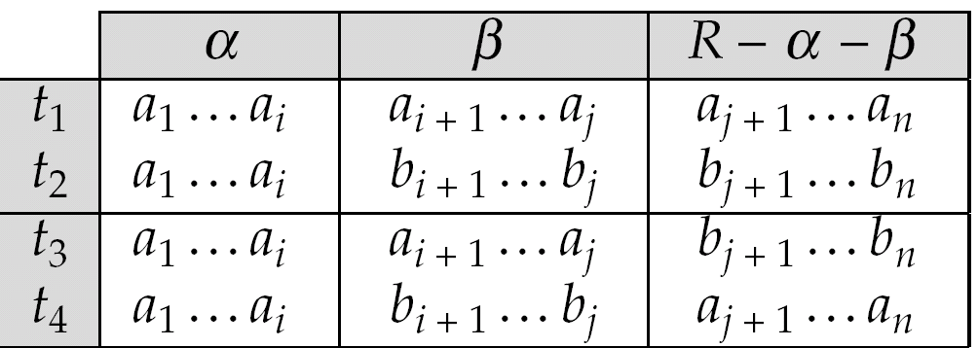
MVD (Cont.)
Tabular representation of α →→ β

Slide 61
Example
Let R be a relation schema with a set of attributes that are partitioned into 3 nonempty subsets.
Y, Z, W
We say that Y →→ Z (Y multidetermines Z ) if and only if for all possible relations r (R )
< y₁, z₁, w₁ > ∈ r and < y₁, z₂, w₂ > ∈ r
then
< y₁, z₁, w₂ > ∈ r and < y₁, z₂, w₁ > ∈ r
Note that since the behavior of Z and W are identical it follows that
Y →→ Z if Y →→ W

Slide 62
Example (Cont.)
In our example:
course →→ teacher course →→ book
The above formal definition is supposed to formalize the notion that given a particular value of Y (course) it has associated with it a set of values of Z (teacher) and a set of values of W (book), and these two sets are in some sense independent of each other.
Note:
If Y → Z then Y →→ Z
Indeed we have (in above notation) Z₁ = Z₂ The claim follows.

Slide 63
Use of Multivalued Dependencies
We use multivalued dependencies in two ways:
1. To test relations to determine whether they are legal under a given set of functional and multivalued dependencies
2. To specify constraints on the set of legal relations. We shall thus concern ourselves only with relations that satisfy a given set of functional and multivalued dependencies.
If a relation r fails to satisfy a given multivalued dependency, we can construct a relations r′ that does satisfy the multivalued dependency by adding tuples to r.

Slide 64
Theory of MVDs
From the definition of multivalued dependency, we can derive the following rule:
If α → β, then α →→ β
That is, every functional dependency is also a multivalued dependency
The closure D⁺ of D is the set of all functional and multivalued dependencies logically implied by D.
We can compute D⁺ from D, using the formal definitions of functional dependencies and multivalued dependencies.
We can manage with such reasoning for very simple multivalued dependencies, which seem to be most common in practice
For complex dependencies, it is better to reason about sets of dependencies using a system of inference rules (see Appendix C).

Slide 65
Fourth Normal Form
A relation schema R is in 4NF with respect to a set D of functional and multivalued dependencies if for all multivalued dependencies in D⁺ of the form α →→ β, where α ⊆ R and β ⊆ R, at least one of the following hold:
α →→ β is trivial (i.e., β ⊆ α or α ∪ β = R)
α is a superkey for schema R
If a relation is in 4NF it is in BCNF

Slide 66
Restriction of Multivalued Dependencies
The restriction of D to R_{i} is the set D_{i} consisting of
All functional dependencies in D⁺ that include only attributes of R_{i}
All multivalued dependencies of the form
α →→ (β ∩ R_{i})
where α ⊆ R_{i} and α →→ β is in D⁺

Slide 67
4NF Decomposition Algorithm
result: = {R}; done := false; compute D⁺; Let D_{i} denote the restriction of D⁺ to R_{i}
while (not done) if (there is a schema R_{i} in result that is not in 4NF) then begin
let α →→ β be a nontrivial multivalued dependency that holds on R_{i} such that α → R_{i} is not in D_{i}, and α∩β=φ; result := (result - R_{i}) ∪ (R_{i} - β) ∪ (α, β); end else done:= true;
Note: each R_{i} is in 4NF, and decomposition is lossless-join

Slide 68
Example
R =(A, B, C, G, H, I)
F ={ A →→ B
B →→ HI
CG →→ H }
R is not in 4NF since A →→ B and A is not a superkey for R
Decomposition
a) R₁ = (A, B) (R₁ is in 4NF)
b) R₂ = (A, C, G, H, I) (R₂ is not in 4NF)
c) R₃ = (C, G, H) (R₃ is in 4NF)
d) R₄ = (A, C, G, I) (R₄ is not in 4NF)
Since A →→ B and B →→ HI, A →→ HI, A →→ I
e) R₅ = (A, I) (R₅ is in 4NF)
f)R₆ = (A, C, G) (R₆ is in 4NF)

Slide 69
Further Normal Forms
Join dependencies generalize multivalued dependencies
lead to project-join normal form (PJNF) (also called fifth normal form)
A class of even more general constraints, leads to a normal form called domain-key normal form.
Problem with these generalized constraints: are hard to reason with, and no set of sound and complete set of inference rules exists.
Hence rarely used

Slide 70
Overall Database Design Process
We have assumed schema R is given
R could have been generated when converting E-R diagram to a set of tables.
R could have been a single relation containing all attributes that are of interest (called universal relation).
Normalization breaks R into smaller relations.
R could have been the result of some ad hoc design of relations, which we then test/convert to normal form.

Slide 71
ER Model and Normalization
When an E-R diagram is carefully designed, identifying all entities correctly, the tables generated from the E-R diagram should not need further normalization.
However, in a real (imperfect) design, there can be functional dependencies from non-key attributes of an entity to other attributes of the entity
Example: an employee entity with attributes department_number and department_address, and a functional dependency department_number → department_address
Good design would have made department an entity
Functional dependencies from non-key attributes of a relationship set possible, but rare --- most relationships are binary

Slide 72
Denormalization for Performance
May want to use non-normalized schema for performance
For example, displaying customer_name along with account_number and balance requires join of account with depositor
Alternative 1: Use denormalized relation containing attributes of account as well as depositor with all above attributes
faster lookup
extra space and extra execution time for updates
extra coding work for programmer and possibility of error in extra code
Alternative 2: use a materialized view defined as account depositor
Benefits and drawbacks same as above, except no extra coding work for programmer and avoids possible errors

Slide 73
Other Design Issues
Some aspects of database design are not caught by normalization
Examples of bad database design, to be avoided:
Instead of earnings (company_id, year, amount ), use
earnings_2004, earnings_2005, earnings_2006, etc., all on the schema (company_id, earnings).
Above are in BCNF, but make querying across years difficult and needs new table each year
company_year(company_id, earnings_2004, earnings_2005, earnings_2006)
Also in BCNF, but also makes querying across years difficult and requires new attribute each year.
Is an example of a crosstab, where values for one attribute become column names
Used in spreadsheets, and in data analysis tools

Slide 74
Modeling Temporal Data
Temporal data have an association time interval during which the data are valid.
A snapshot is the value of the data at a particular point in time
Several proposals to extend ER model by adding valid time to
attributes, e.g. address of a customer at different points in time
entities, e.g. time duration when an account exists
relationships, e.g. time during which a customer owned an account
But no accepted standard
Adding a temporal component results in functional dependencies like
customer_id → customer_street, customer_city
not to hold, because the address varies over time
A temporal functional dependency X 🡪 Y holds on schema R if the functional dependency X 🡪 Y holds on all snapshots for all legal instances r (R )
t

Slide 75
Modeling Temporal Data (Cont.)
In practice, database designers may add start and end time attributes to relations
E.g. course(course_id, course_title) 🡪
course(course_id, course_title, start, end)
Constraint: no two tuples can have overlapping valid times
Hard to enforce efficiently
Foreign key references may be to current version of data, or to data at a point in time
E.g. student transcript should refer to course information at the time the course was taken

Slide 76
End of Chapter

Slide 77
Proof of Correctness of 3NF Decomposition Algorithm

Slide 78
Correctness of 3NF Decomposition Algorithm
3NF decomposition algorithm is dependency preserving (since there is a relation for every FD in F_{c})
Decomposition is lossless
A candidate key (C ) is in one of the relations R_{i} in decomposition
Closure of candidate key under F_{c} must contain all attributes in R.
Follow the steps of attribute closure algorithm to show there is only one tuple in the join result for each tuple in R_{i}

Slide 79
Correctness of 3NF Decomposition Algorithm (Cont’d.)
Claim: if a relation R_{i} is in the decomposition generated by the
above algorithm, then R_{i} satisfies 3NF.
Let R_{i} be generated from the dependency α → β
Let γ → B be any non-trivial functional dependency on R_{i}. (We need only consider FDs whose right-hand side is a single attribute.)
Now, B can be in either β or α but not in both. Consider each case separately.

Slide 80
Correctness of 3NF Decomposition (Cont’d.)
Case 1: If B in β:
If γ is a superkey, the 2nd condition of 3NF is satisfied
Otherwise α must contain some attribute not in γ
Since γ → B is in F⁺ it must be derivable from F_{c}, by using attribute closure on γ.
Attribute closure not have used α →β. If it had been used, α must be contained in the attribute closure of γ, which is not possible, since we assumed γ is not a superkey.
Now, using α→ (β- {B}) and γ → B, we can derive α →B
(since γ ⊆ α β, and B ∉ γ since γ → B is non-trivial)
Then, B is extraneous in the right-hand side of α →β; which is not possible since α →β is in F_{c}.
Thus, if B is in β then γ must be a superkey, and the second condition of 3NF must be satisfied.

Slide 81
Correctness of 3NF Decomposition (Cont’d.)
Case 2: B is in α.
Since α is a candidate key, the third alternative in the definition of 3NF is trivially satisfied.
In fact, we cannot show that γ is a superkey.
This shows exactly why the third alternative is present in the definition of 3NF.
Q.E.D.

Slide 82
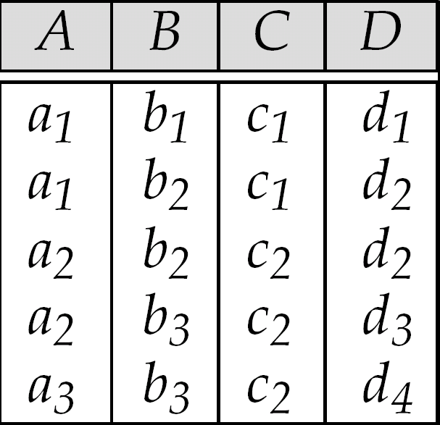
Figure 7.5: Sample Relation r

Slide 83
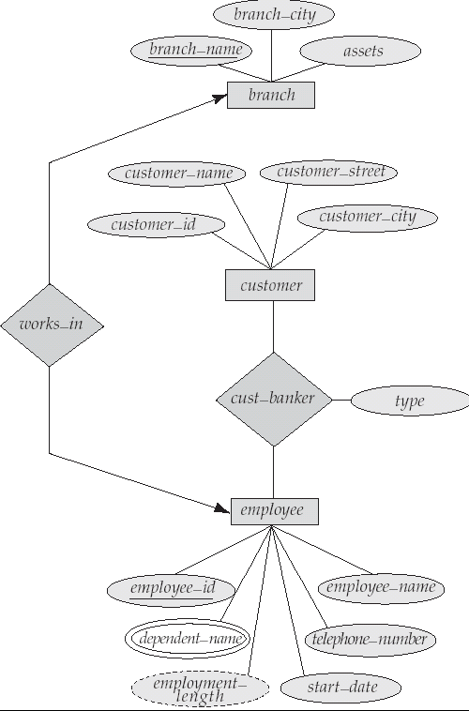
Figure 7.6

Slide 84
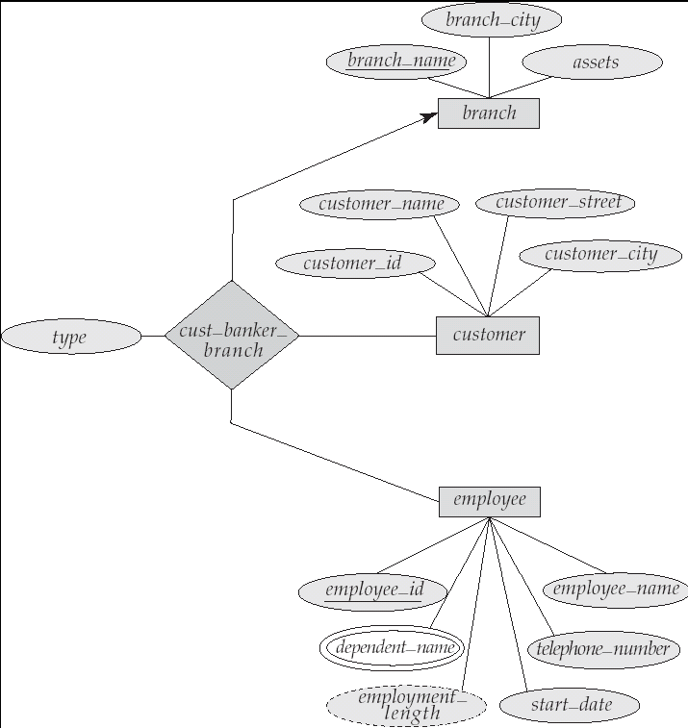
Figure 7.7

Slide 85
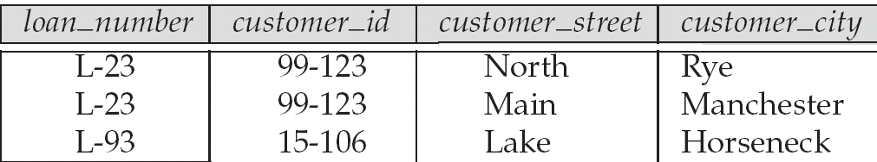
Figure 7.15: An Example of Redundancy in a BCNF Relation

Slide 86
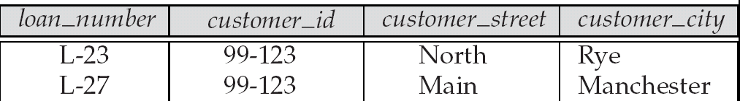
Figure 7.16: An Illegal R₂ Relation

Slide 87
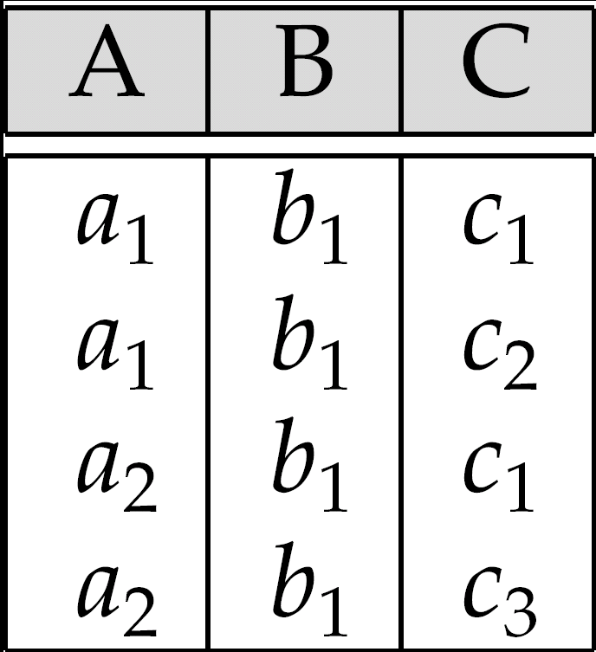
Figure 7.18: Relation of Practice Exercise 7.2

